Slide 1
If you do not act within 48 hours you probably never will – act TODAY! ☺
What is your single most important insight from this presentation?
What is the single most practical action that you can take tomorrow to apply ERP more effectively?

Slide 2
Design ERP and IT solutions like bridges ...
Not to fall down but to last

Slide 3
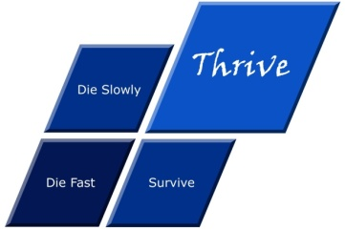
Acknowledgements
My clients, associates and staff
My parents Angus and Thelma
My wife Erba
My children Alexandra and Struan
Other significant people in my life who have
contributed to me gaining this knowledge
Psalm 136:5 "To Him who by wisdom made the heavens, for His mercy endures forever;"
Assisting clients to thrive through the effective strategic application of IT and ERP

Slide 4
Questions?
Dr James Robertson PrEng
James A Robertson & Associates
www.James-A-Robertson-and-Associates.com
email: James@JamesARobertson.com
LinkedIn: http://za.LinkedIn.com/in/DrJamesARobertsonERPDoctor
Please remember to complete the evaluation forms
Finding the missing pieces of your I.T. and strategy puzzles

